Slide 1
Template for student stories

Slide 3
Insert photo here
Insert quote (you may copy from CEDARS website – student stories) /
programme name here
(Student’ name)
(Faculty / participated CEDARS Programme name)

Slide 4
Sample

Slide 5
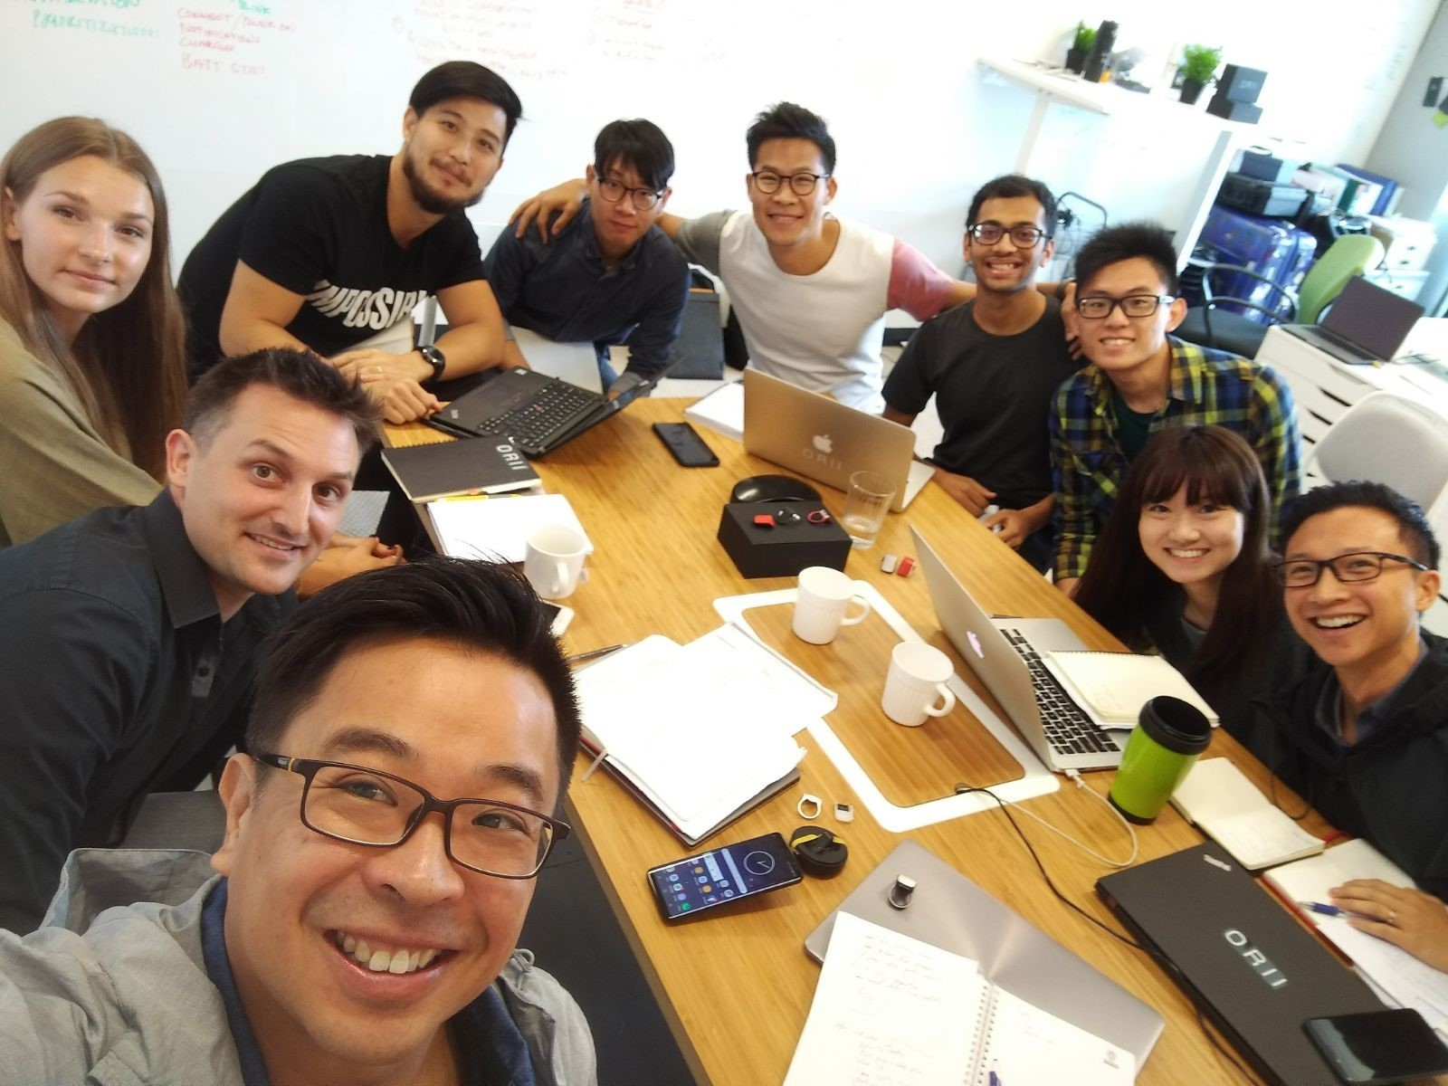
"Oscar was thrilled, as he immediately realized how challenging and fun this internship was going to be."
Chan Shu Hin, Oscar
Who participated in [CEDARS HOUSE] Intern with Founder

Slide 6
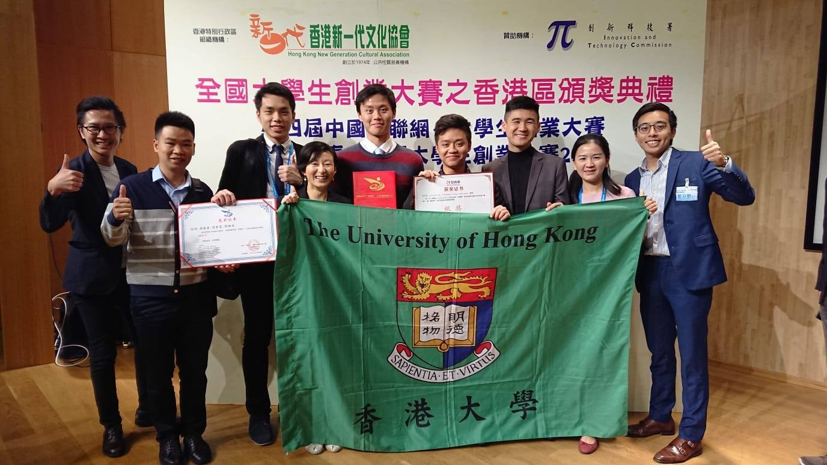
Awarded in
4th China “Internet+” College Students Innovation and Entrepreneurship Competition
Chan Ying Tung, Lily
(Li Ka Shing Faculty of Medicine)

