Slide 1

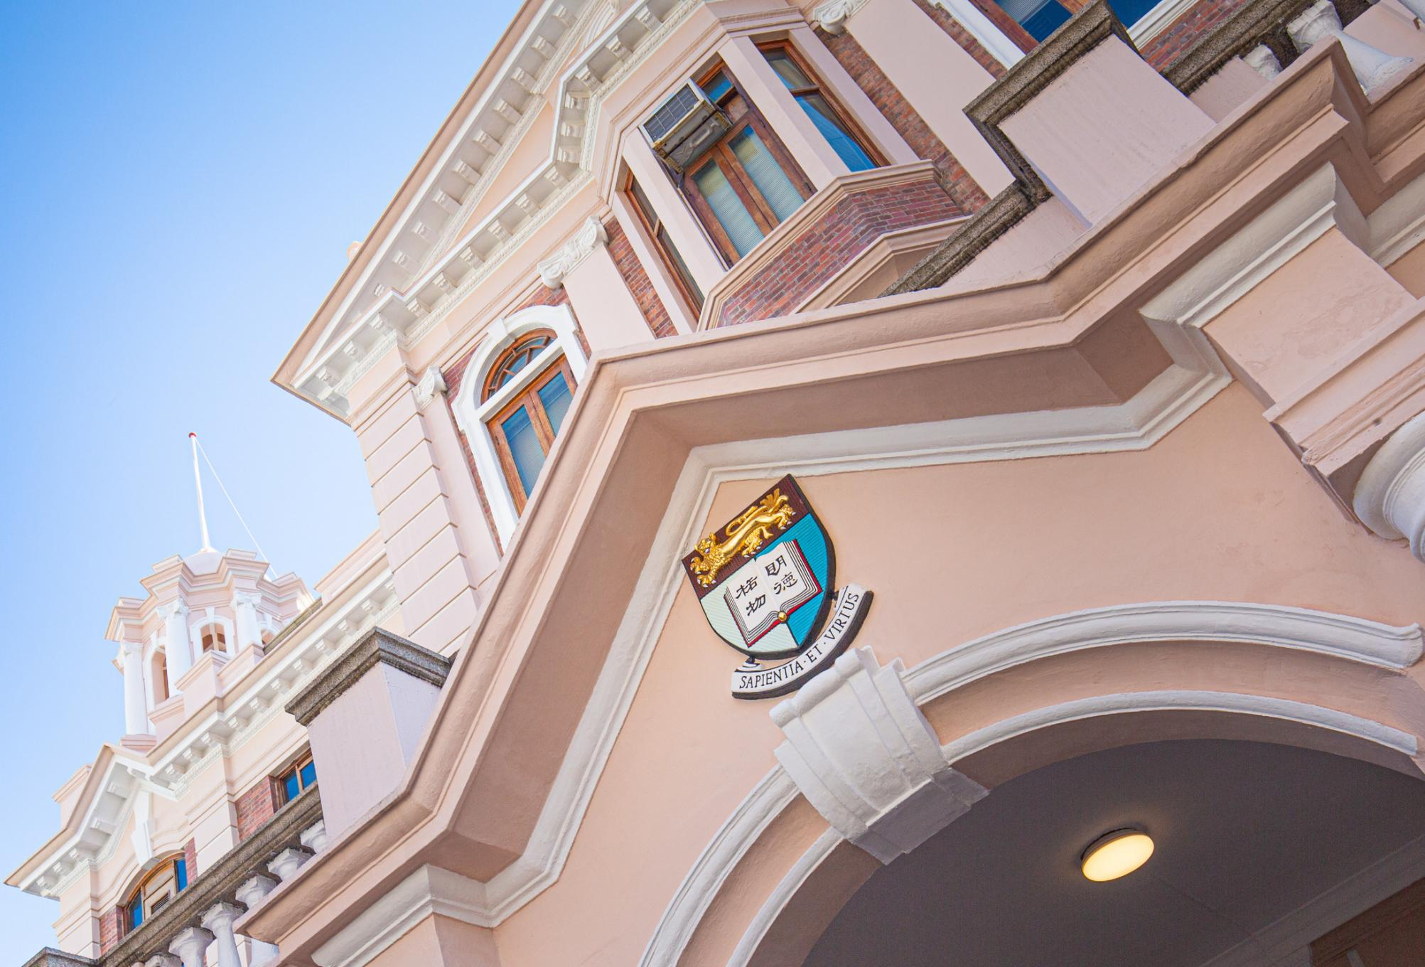


DREAMS
Department of Electrical and Computer Engineering

Slide 2

BEng in
Computer (CE)
Electrical (EE)
Electronic (ElecE)
Engineering
(JS6987)
Notes:
The Department of Electrical and Computer Engineering (ECE) was established in 1960 as a major department in the Faculty of Engineering at The University of Hong Kong. Its graduates have played a vital role in advancing society and have made a significant impact on the well-being and development of Hong Kong during its formative years.
Over the years, power systems, electronics, computing, and information processing have evolved at dazzling speed, permeating every aspect of modern life. The ECE Department has naturally progressed with time and has grown from the relatively obscure location along Pokfulam Road to the current modern high-rise of the Chow Yei Ching Building (map), with numerous satellite laboratories located in the Haking Wong Building, Yam Pak Building and Composite Building.
Department of Electrical and Computer Engineering (ECE) was formerly known as Department of Electrical and Electronic Engineering (EEE), effective since February 2026.
https://ece.hku.hk/about/

Slide 3

OUR DEPARTMENT
OUR
COMMUNITY
Electrical and Computer Engineering (ECE)
QS World University
Rankings by Subject 2026
Home to over
Electrical and Electronic Engineering
60
625
700
st
51
World
Computer Science & Information Systems
Faculty Members
Undergraduate Students
MSc Students
27
th
400
Research Postgraduate Students
World
Notes:
Our department is home to over 60 faculty members, over 430 undergraduate students, 700 MSc students, and 350 research postgraduate students pursuing MPhil and PhD degrees. Our faculty members are engaged in cutting-edge research across a broad range of fields, including neuromorphic computing, power electronics, photonics, 6G communications, biomedical engineering (BME), and computer vision.
We take great pride in our global recognition. In the QS Subject Ranking 2025, we are ranked 38th in Electrical and Electronic Engineering and 21st in Computer Science and Information Systems. Our faculty achievements include 4 Clarivate Highly Cited Researchers (2024), 2 members of the Hong Kong Academy of Engineering, 1 Fellow of the National Academy of Inventors, 19 Fellows of the IEEE, and 5 top 1% researchers by Clarivate.
https://ece.hku.hk/about/

Slide 4

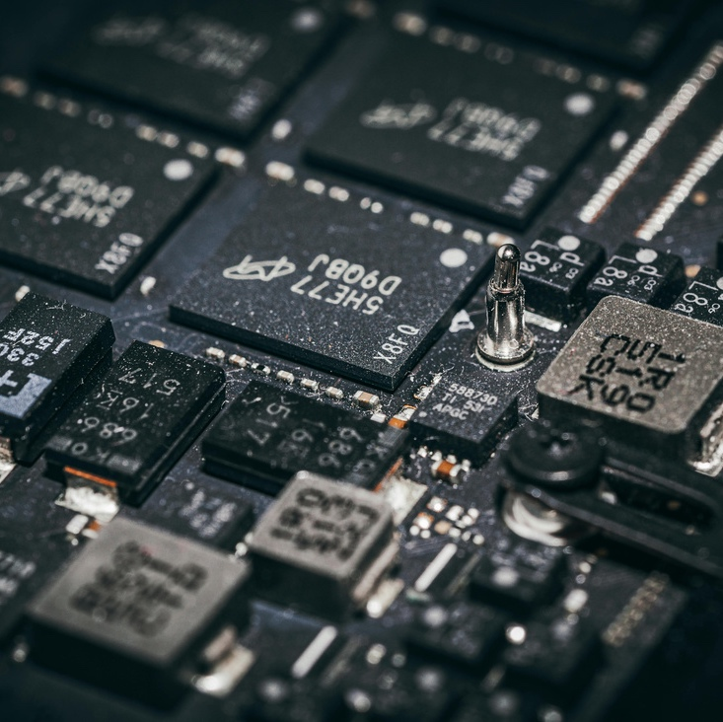
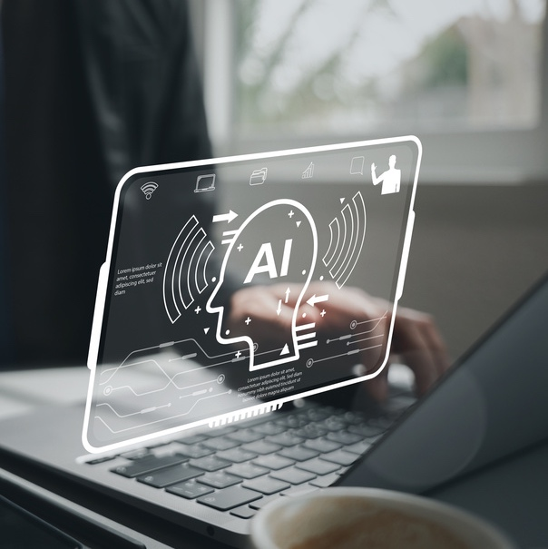
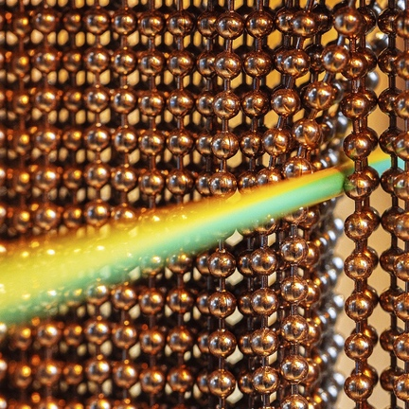
RESEARCH AREAS
Biomedical Engineering
Power Electronics, Electrical Energy and Control Systems
Intelligent Systems, Data
and Networks
Photonics and Electronics
Identify potential
threats and vulnerabilities systematically
Create response plans
for different high-impact
risk scenarios
Conduct practice
simulations with internal
and external teams
Ensure supplies, backups,
and logistics are
ready when needed
Notes:
https://ece.hku.hk/research/research-interests/

Slide 5
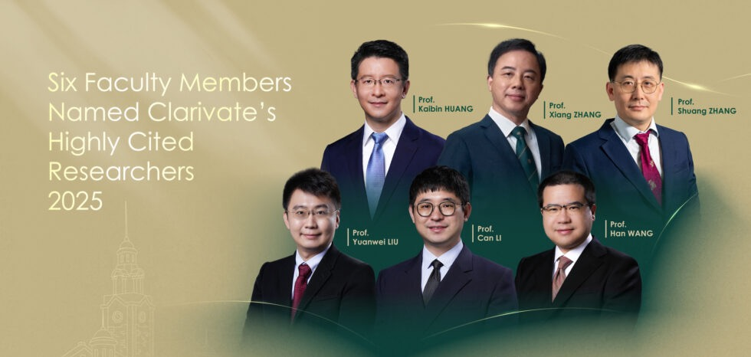
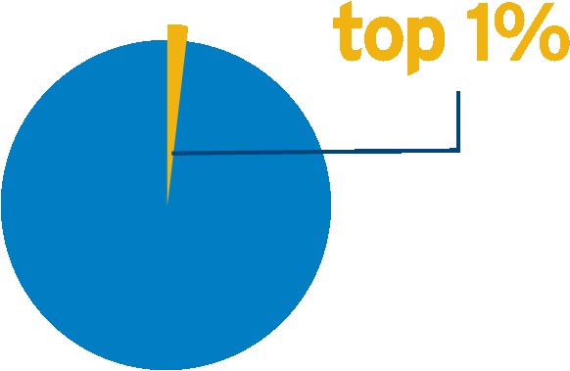
World’s Top 1% Researchers
According to Clarivate Analytics’ Essential Science Indicators, 232 HKU’s scholars recognised as Top 1% Scholars in 2025.
Among them, 14 Top 1% Scholars from ECE:
Professor Chau, Kwok Tong
Professor Choy, Wallace Chik Ho
Professor Du, Hongyang
Professor Hou, Yunhe
Professor Huang, Kaibin
Emeritus Professor Hui, Shu Yuen Ron
Professor Li, Can
Emeritus Professor Li, Victor On Kwok
Professor Liu, Yuanwei
Professor Ngai, Cheuk Han Edith
Professor Peng, Yifan Evan
Professor Wang, Han
Professor Wang, Yi
Professor Zhang, Yuhao
Top 1%
* Names sorted in alphabetical order
* Data Source: Essential Science Indicators (Clarivate)
Notes:
https://ece.hku.hk/research/research-interests/

Slide 6


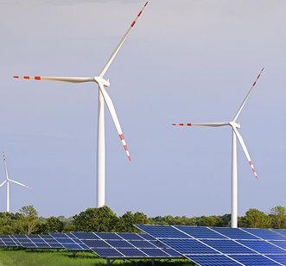

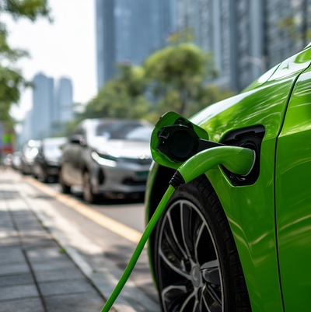
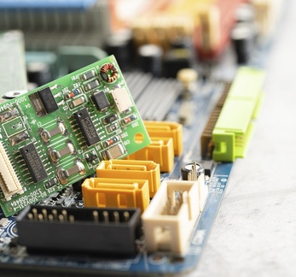
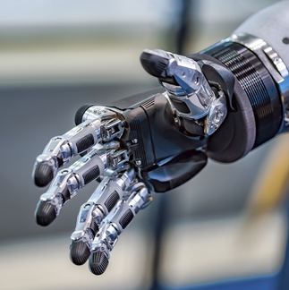

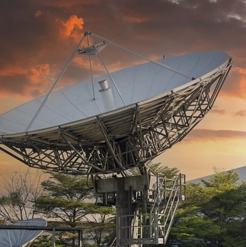
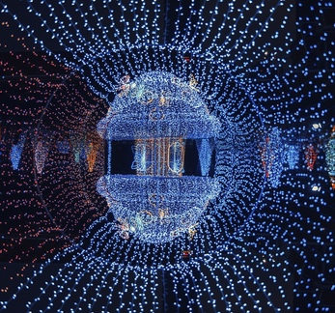
TEACHING AREAS
EE
Electrical Engineering
  Electrical Power
  Energy
Computer Engineering
HKU
ECE
  Data Engineering
  Embedded Systems
  Robotics & Control
CE
ElecE
Electronic Engineering
  Communications
  Photonics
  Signal processing
Notes:
https://ece.hku.hk/study/undergraduate/

Slide 7
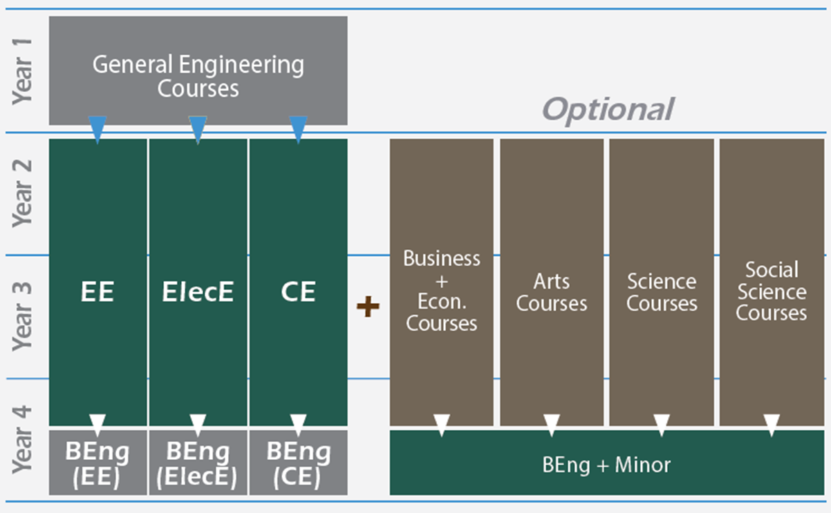
CURRICULUM

Slide 8
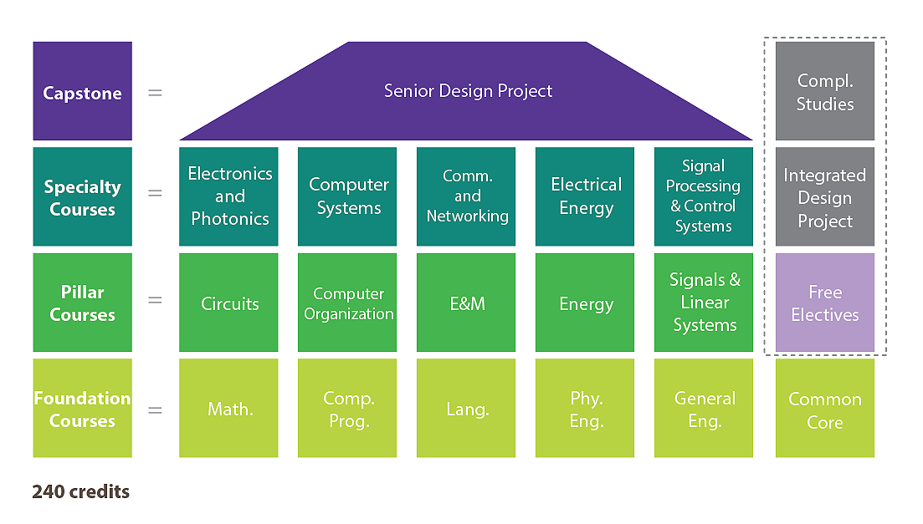
CURRICULUM

Slide 9
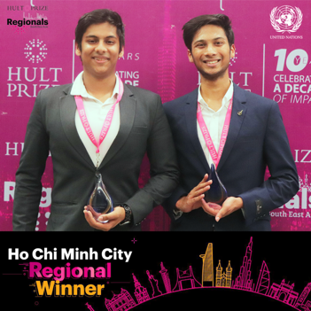
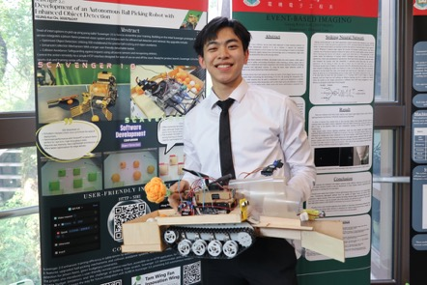
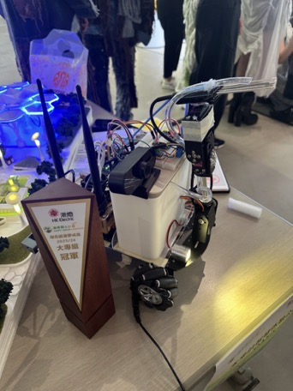
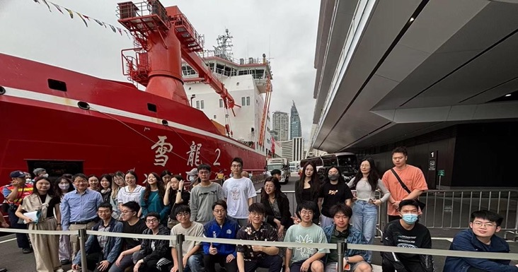
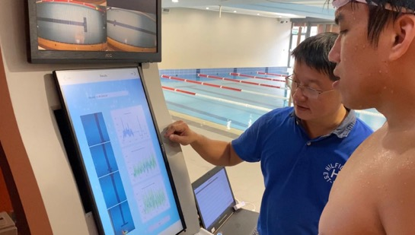
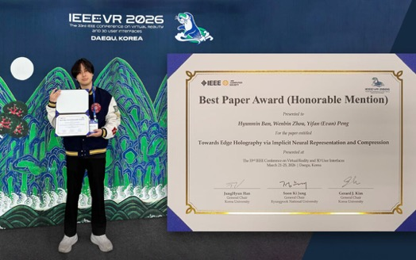
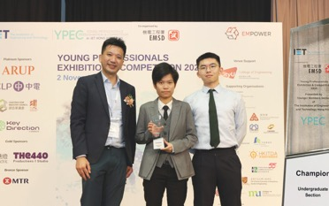
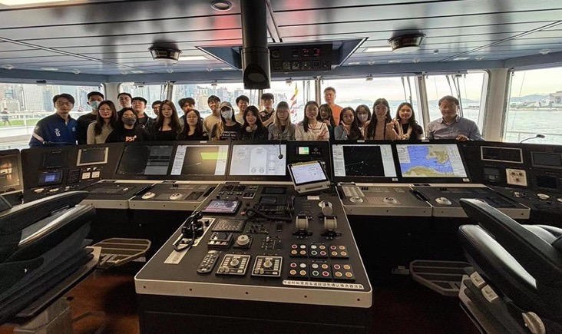
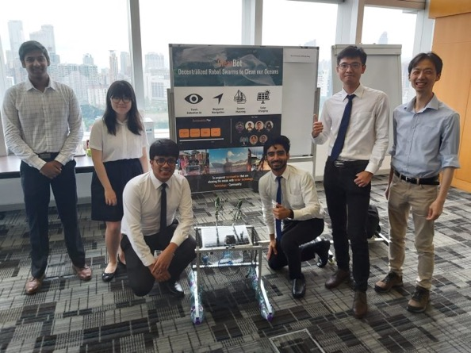
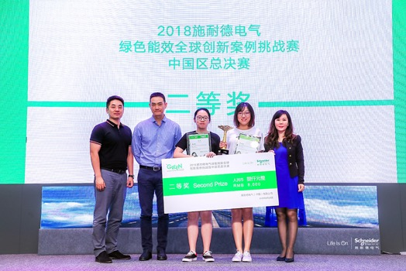
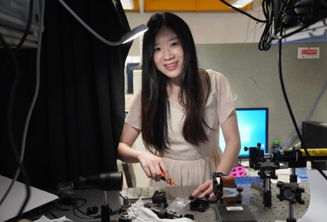
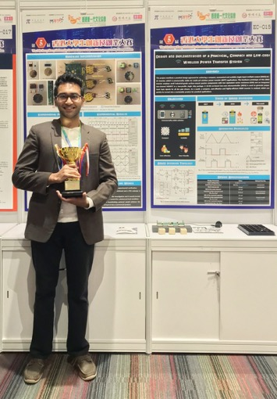
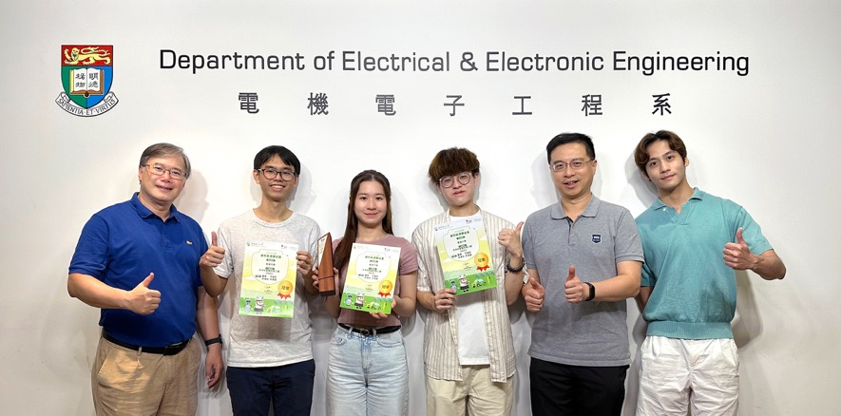
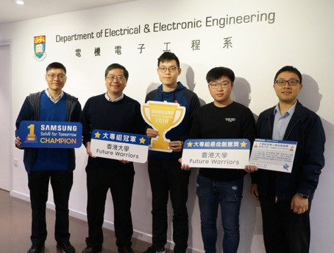
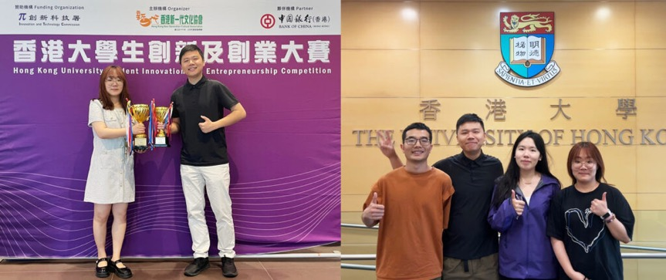
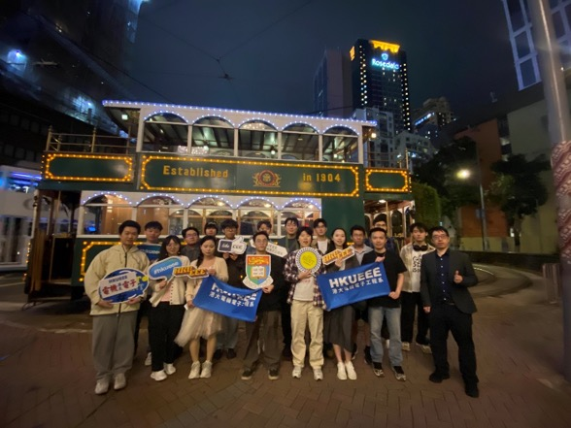
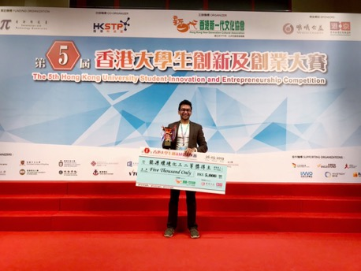
Experiential Learning

Slide 10
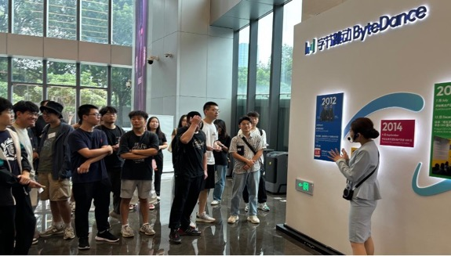
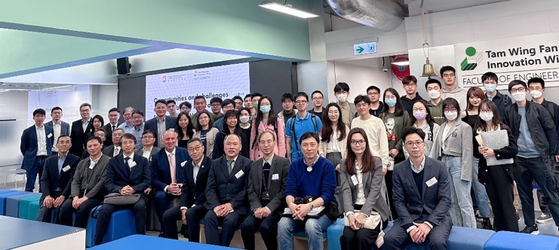
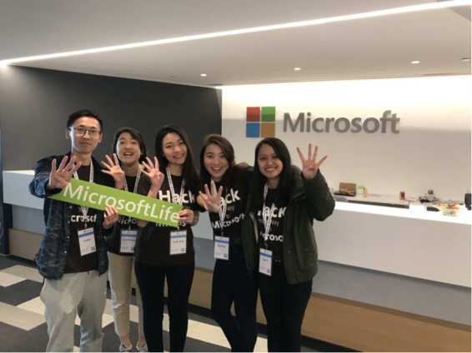
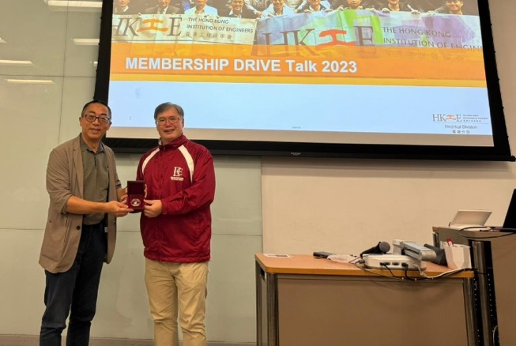
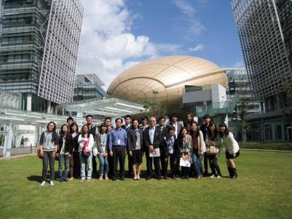
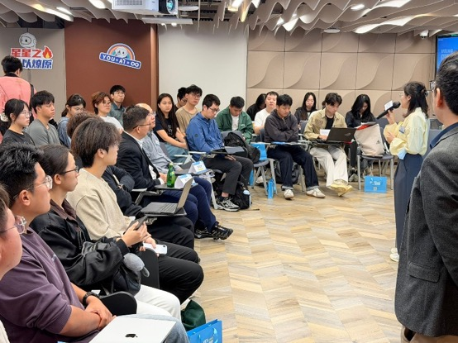
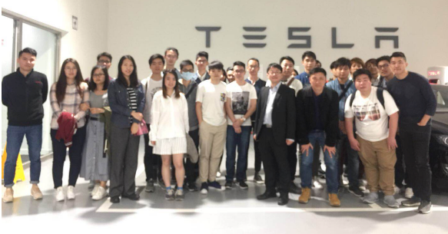
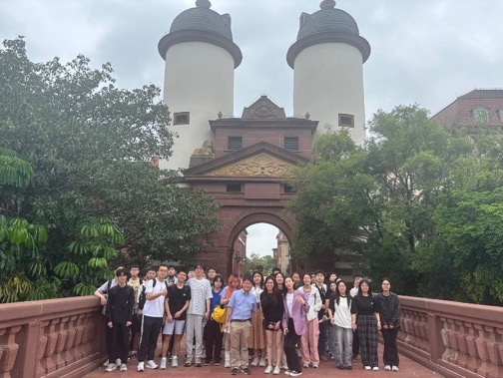
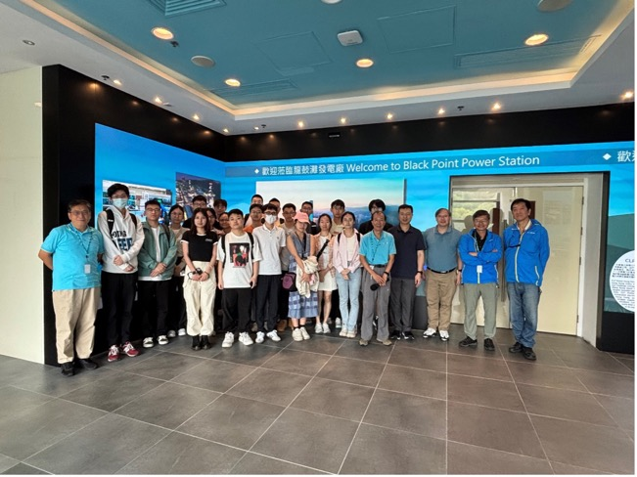
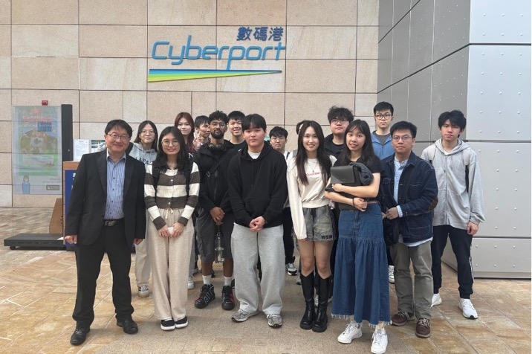
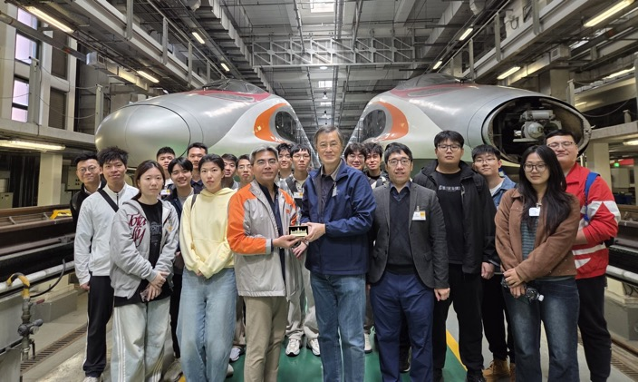
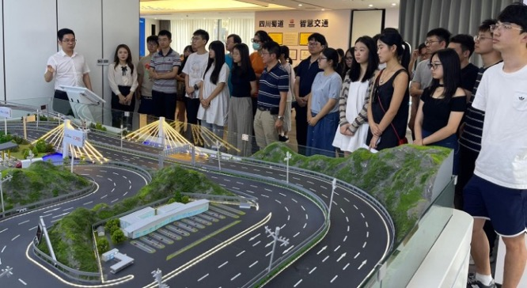
Industry Collaboration

Slide 11
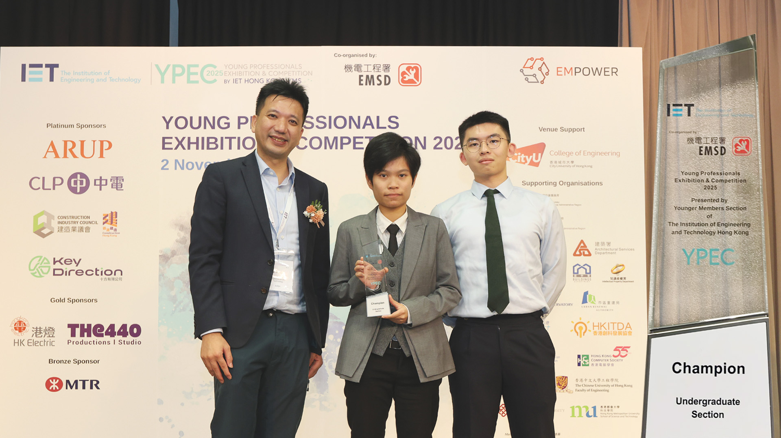
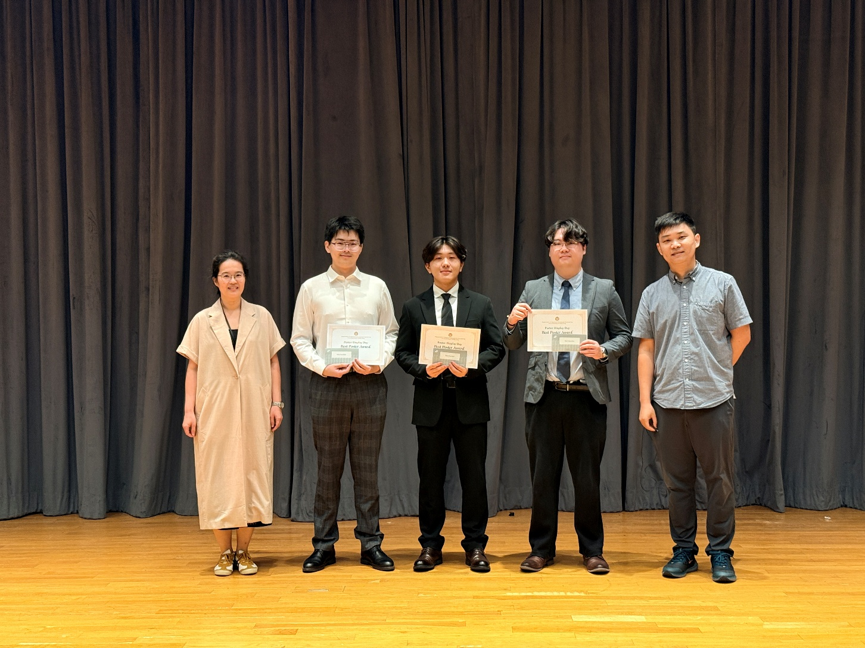
ACTVITIES & AWARDS
Champion Award at IET YPEC 2025 for an Innovative One-Stop AI Elderly Monitoring System
Best and Outstanding Awards at Poster Display Day for ELEC4848 Senior Design Project

Slide 12
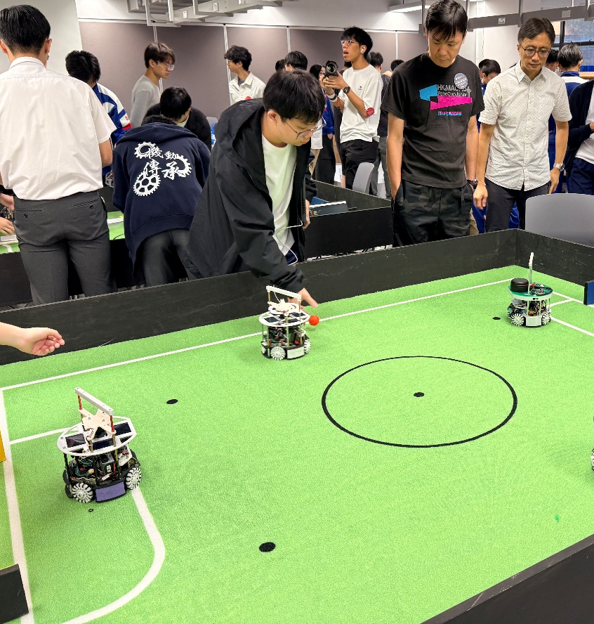
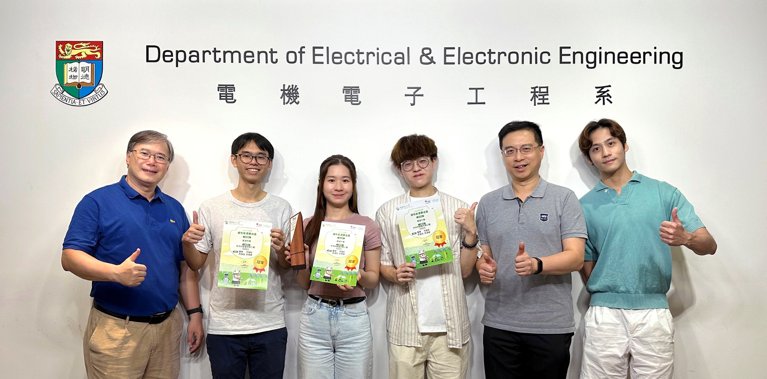
ACTVITIES & AWARDS
Champion Award at Green Energy Dreams Come True Competition (Organised by Hong Kong Electric)
RoboLeague 2026 cum RoboCup Junior China Open (Hong Kong)

Slide 13
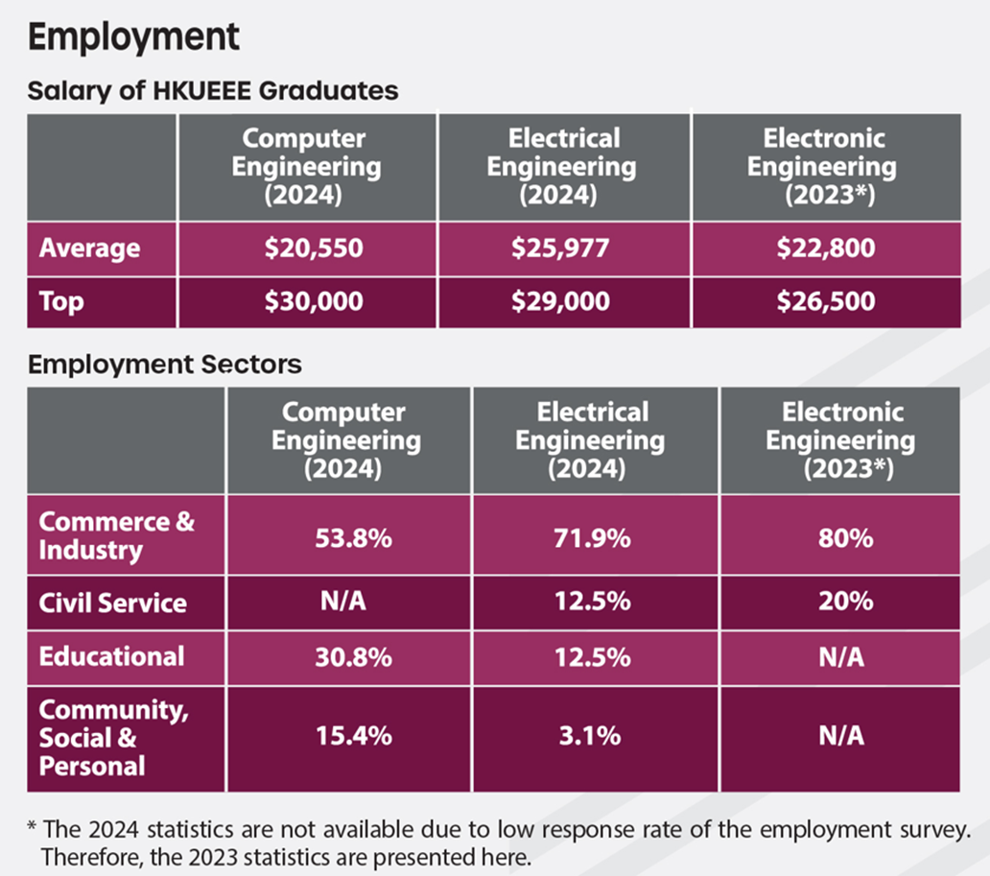
GRADUATE PROSPECTS
HKUECE
and more!

